Slide 1





16 bit Serial in Serial out FIFO Shift Register
EEE -468 (VLSI Circuits and Design Laboratory) Final Project Presentation
Submitted by
Group:07
Md. Jarjis Mondal 1806068
Junaidul Islam Sikder Mehedi Hasan Md Faiyaz Abid
1906041 1906075 1906079

Slide 2
Presentation Outline
Introduction
Design Specifications
Block Diagrams
Verilog Code
Directed Verification
Layered Verification
Optimization
Synthesis
Physical design
Conclusion
16bit Serial in Serial out Register

Slide 3
1. Introduction
A Serial-In Serial-Out shift register is a sequential logic circuit that shifts data in and out one bit at a time in a serial manner. It is made up of a chain of flip-flops connected in series.
In our project, 16 bit data is taken as input and with every clock pulse, data is shifted serially.
This type of shift registers are widely used to store data,signal processing, encryption, frequency divison and so on.
In this project, we have successfully implemented our design using System verilog. Directed Verification and layered verification are also done.
Finally we have synthesized our design using cadence innovus and cadence virtuoso.
16bit Serial in Serial out Register

Slide 4
2. Design Specifications
16 bits are allocated for parallel load, A(15:0)
1 bit serial input, Din.
1bit serial output, Dout.
Clock is used to shift the data in a synchronized way.
It will perform left shift operation when ‘left’ is HIGH otherwise right shifting will take place.
It will load the data if ‘load’ is HIGH otherwise shifting operation will be continued.
16bit Serial in Serial out Register

Slide 5
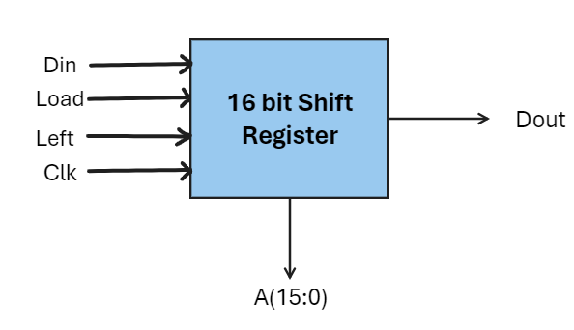
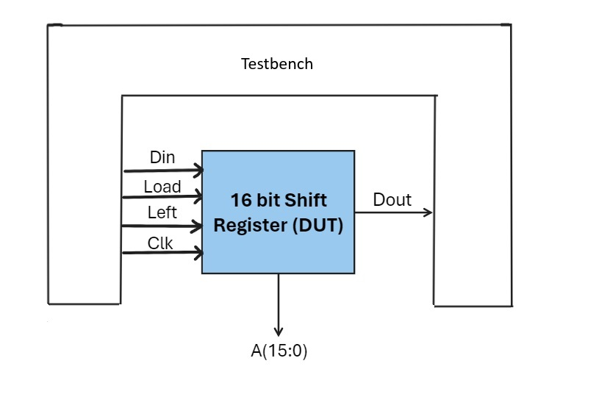
3. Block Diagrams

Slide 6
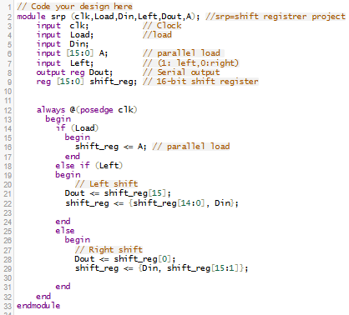
4. Verilog code
16bit Serial in Serial out Register

Slide 7
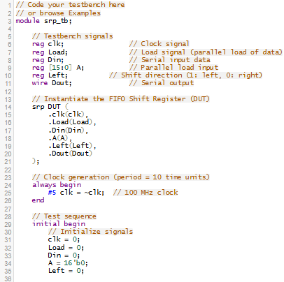
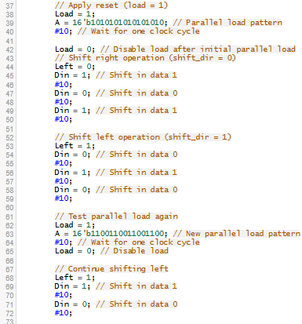
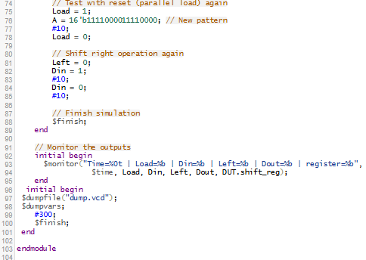
5.1 Directed Verification

Slide 8
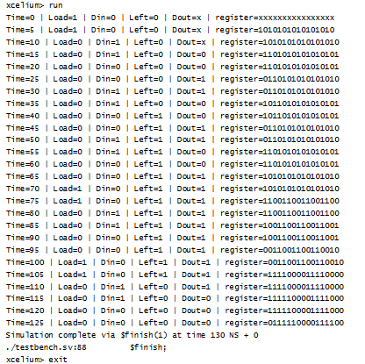
5.2 Output of directed verification:
Using EdaPlayground

Slide 9
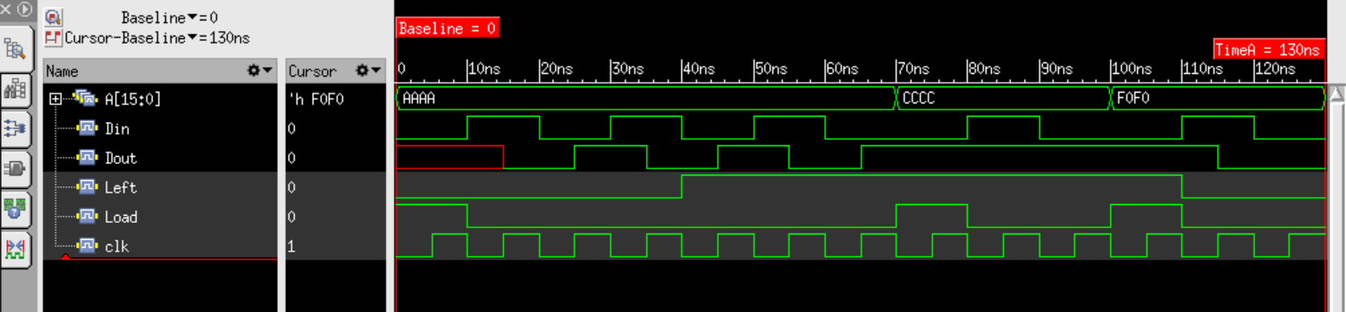
Using Cadence NCsim
16bit Serial in Serial out Register

Slide 10
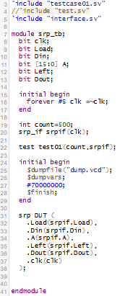
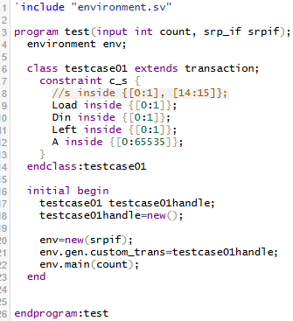
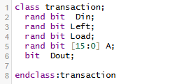
6.1 Layered Verification
testbench.sv testcase01.sv transaction.sv

Slide 11
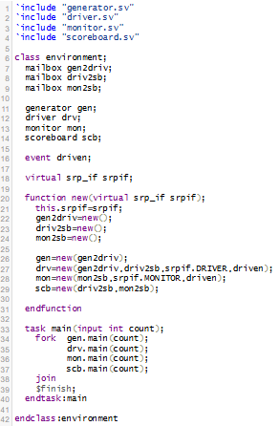
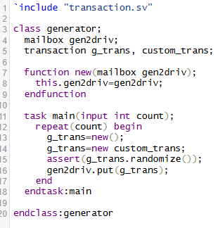
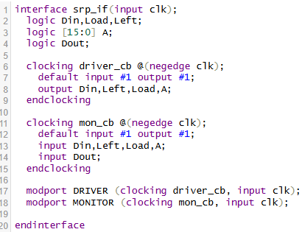
generator.sv interface.sv
environment.sv

Slide 12
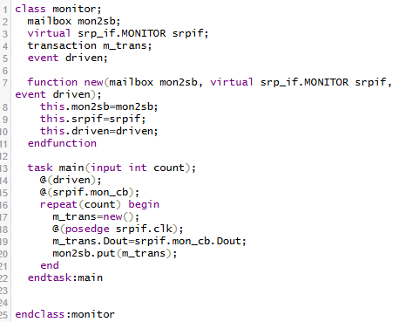
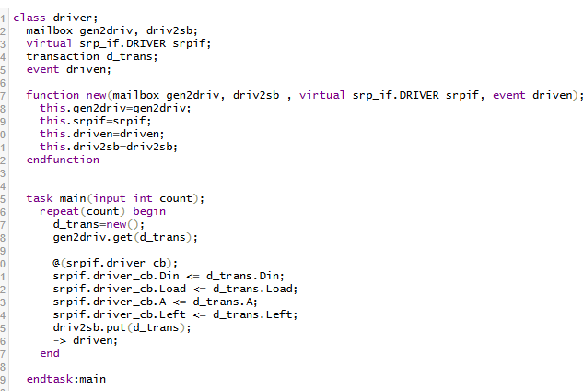
monitor.sv driver.sv

Slide 13
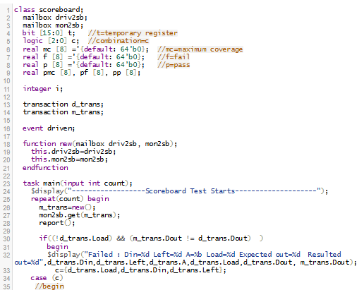
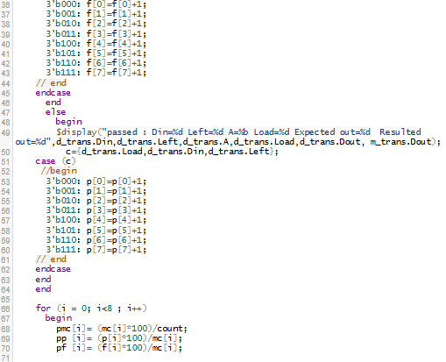
scoreboard.sv

Slide 14
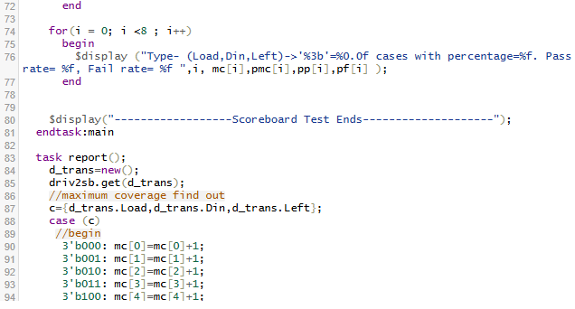
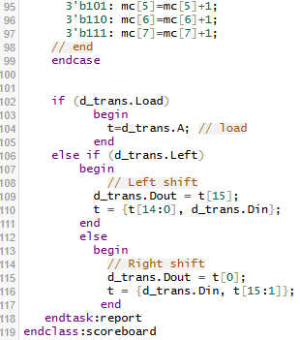
scoreboard.sv
16bit Serial in Serial out Register

Slide 15
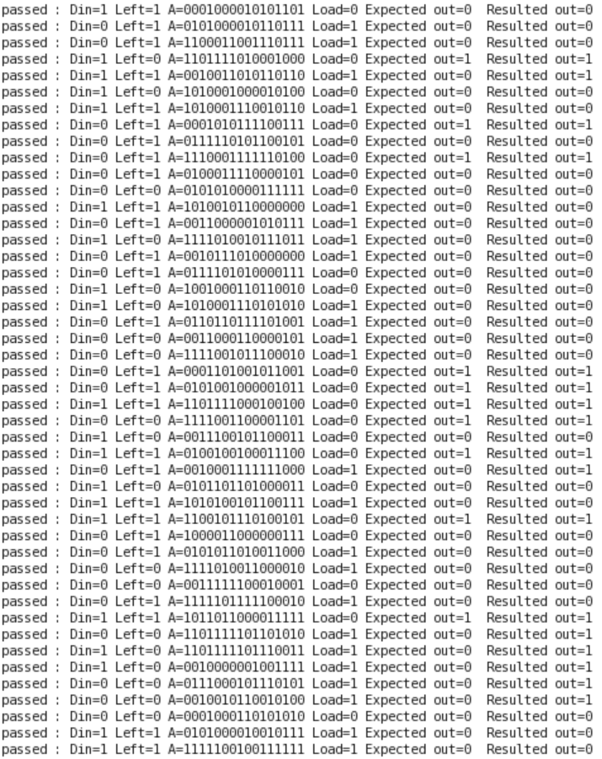
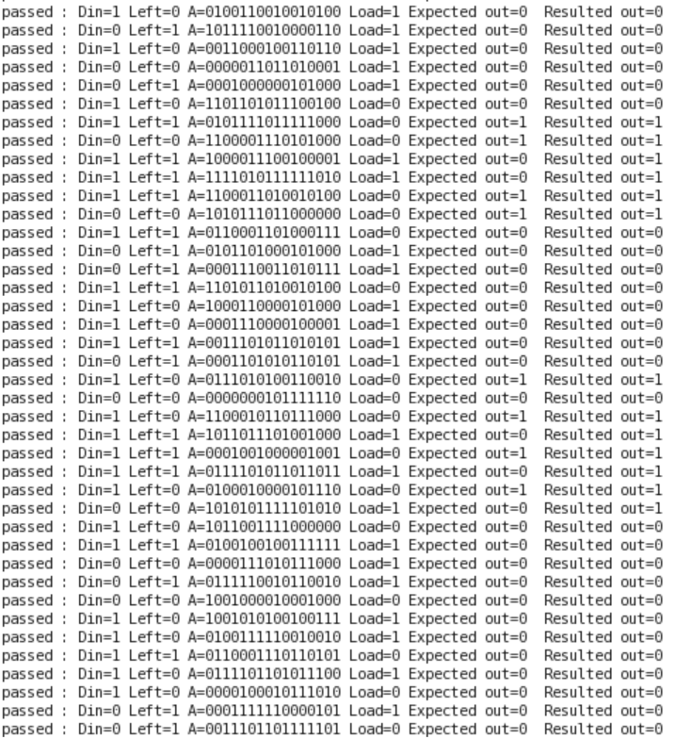
6.2 Output of Layered Testbench

Slide 16
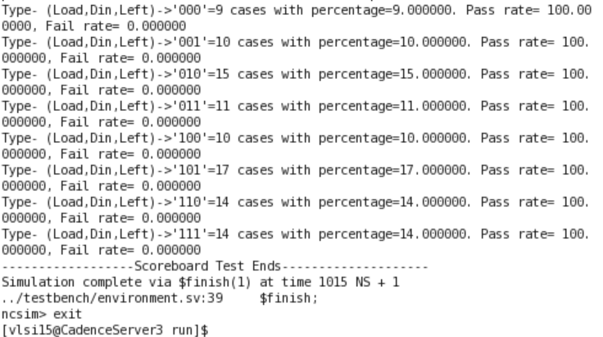
Maximum coverage Count=100

Slide 17
7 Optimization
We have to optimize the clock frequency, input delay and output delay keeping set up time and hold time fixed.
For greater performance, we look forward to minimum area and power consumption in our design.
We are going to sweep those three parameters and observe the area and power reports to identify our optimized design parameters.

Slide 18
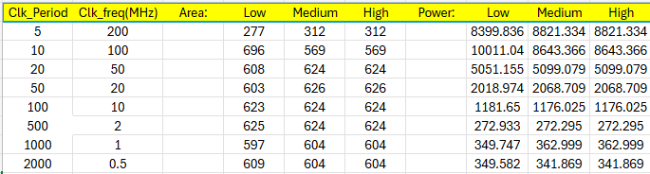
7.1 Optimizing Clock frequency
Data extracted from area and power reports for various clock frequencies

Slide 19
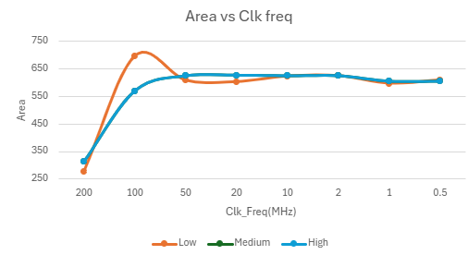
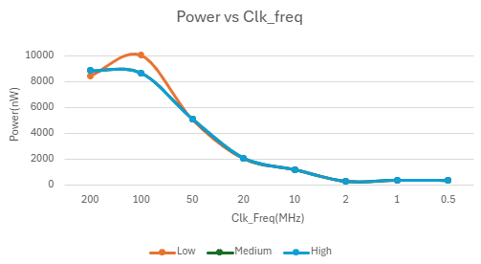
Plots
From the plots, we have considered 2MHz as our optimum clock frequency.

Slide 20
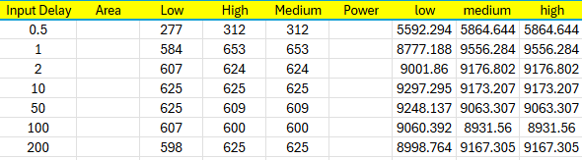
7.2 Optimizing Input Delay
Data extracted from area and power reports for various input delays

Slide 21
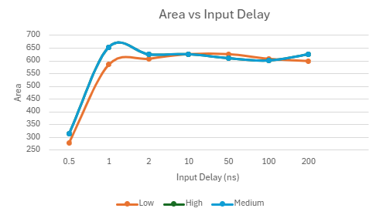
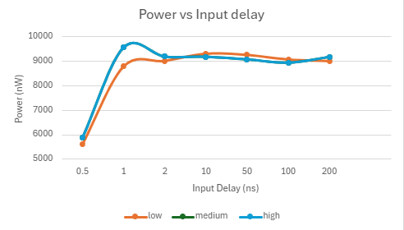
Plots
From the plots, we have considered 0.5 ns as our optimum input delay.

Slide 22
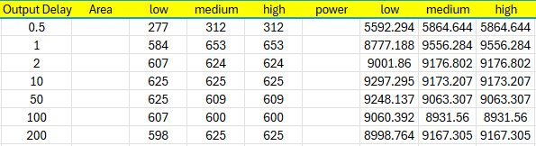
7.3 Optimizing Output Delay
Data extracted from area and power reports for various input delays

Slide 23
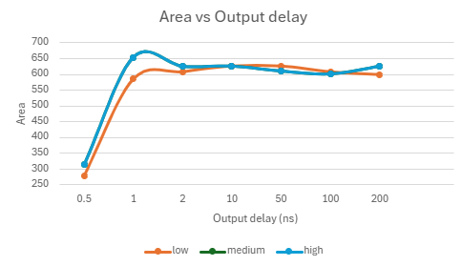
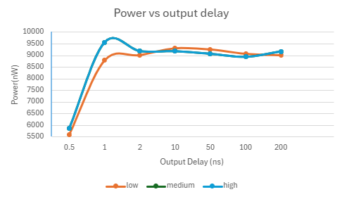
Plots
From the plots, we have considered 0.5 ns as our optimum output delay.

Slide 24
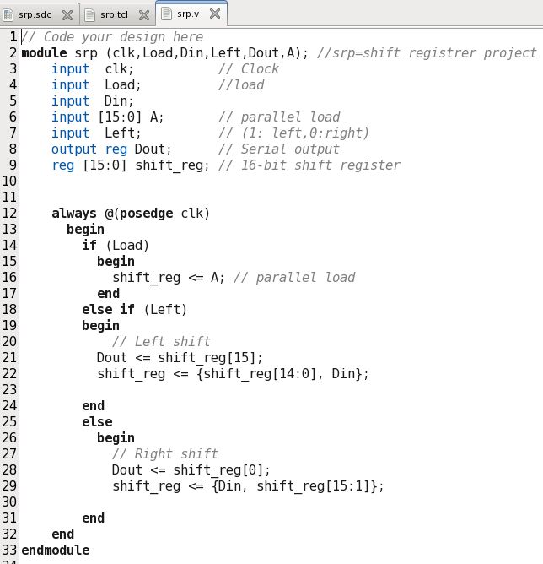
8.1 Our Behavioural code (srp.v)

Slide 25
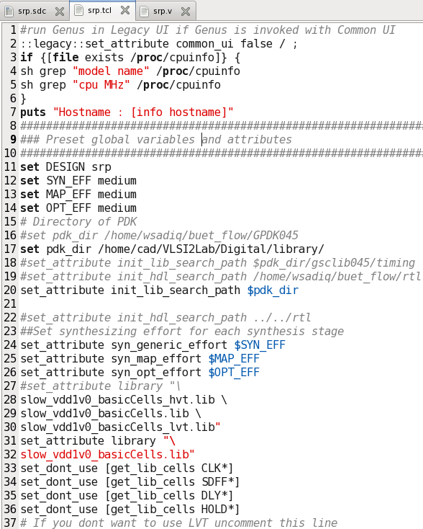
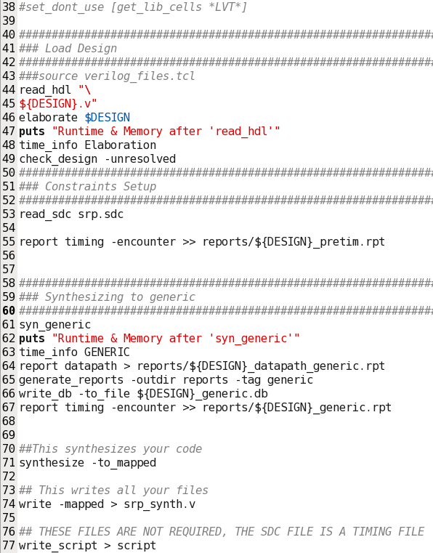
8.2 Converting to synthesized Netlist (srp.tcl)

Slide 26
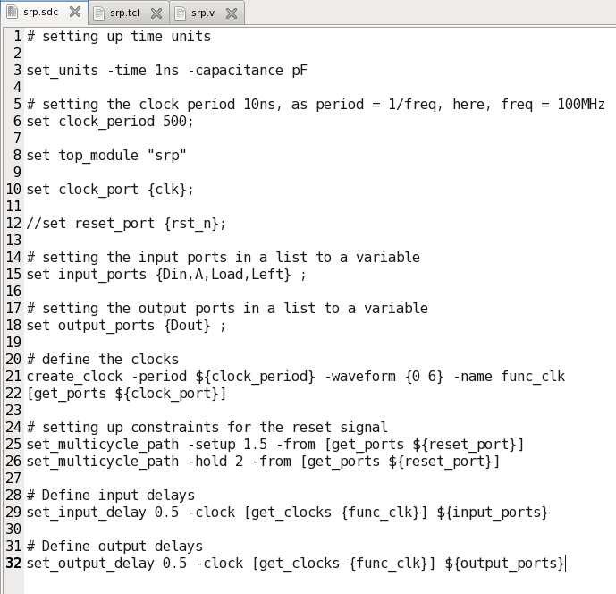
8.3 Synopsys design constraints file (srp.sdc)

Slide 27
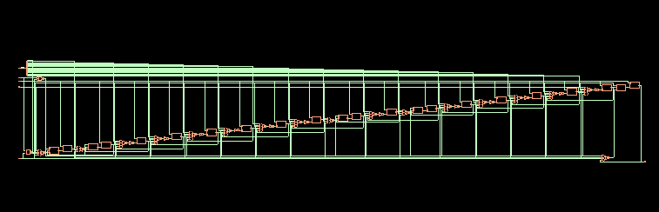
8.4 Area and Power reports of the optimized design
Synthesized Design

Slide 28
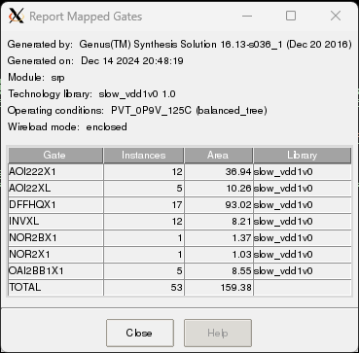
Summary Report

Slide 29
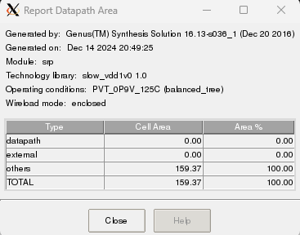
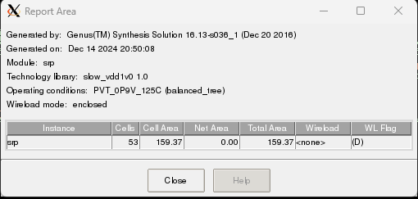
Area Report

Slide 30
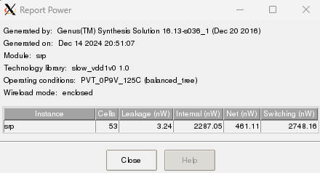
Detailed Power Report

Slide 31
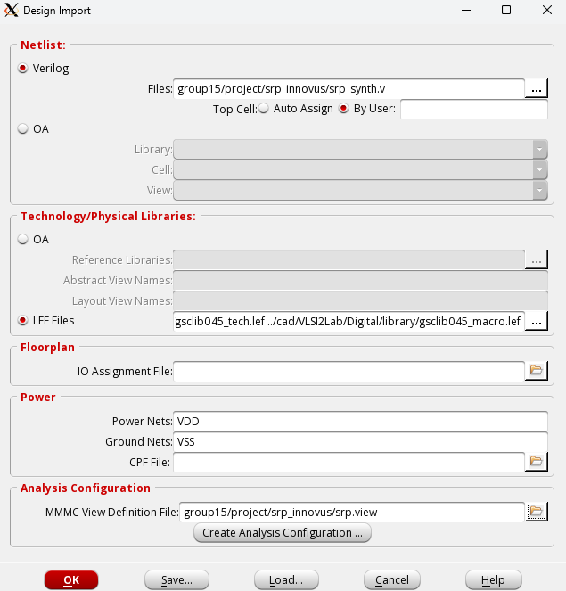
9.1 Physical Design
Physical Design is done
in Cadence Innovus.
At first, we have imported
our synthesized and
optimized design in Innovus.

Slide 32
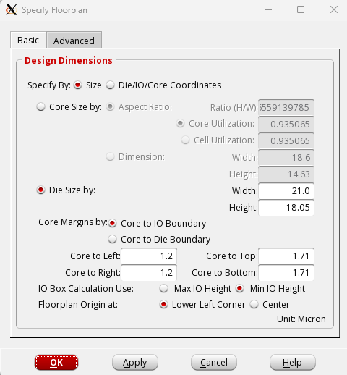
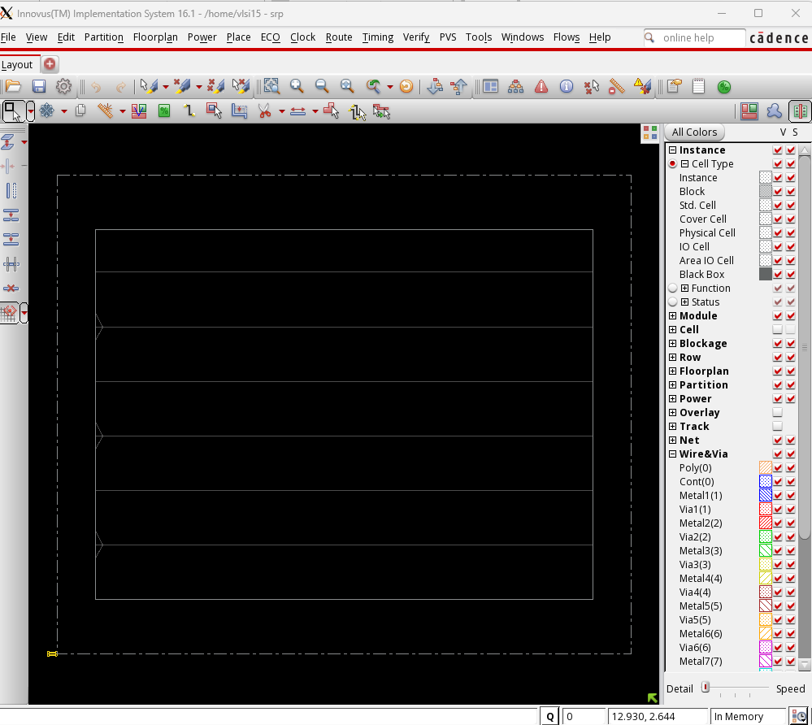
9.2 Physical Design(Floorplaning)

Slide 33
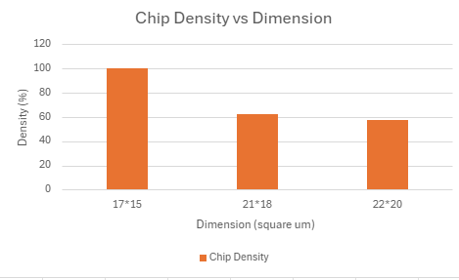
We have used 21*18 sq micron as our optimum dimension.

Slide 34
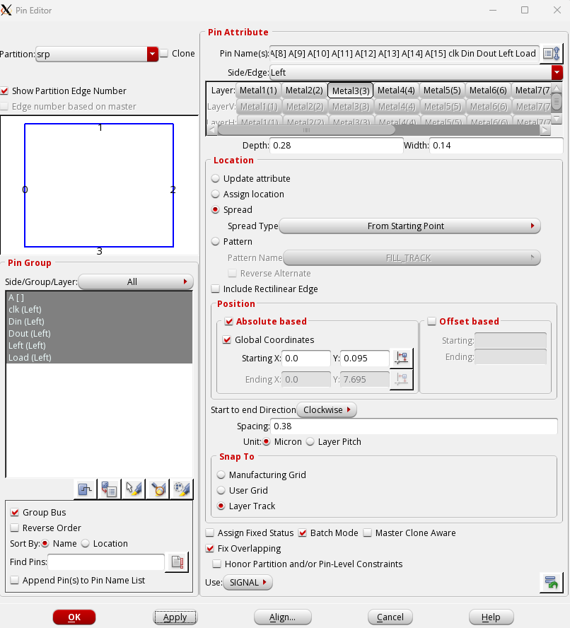
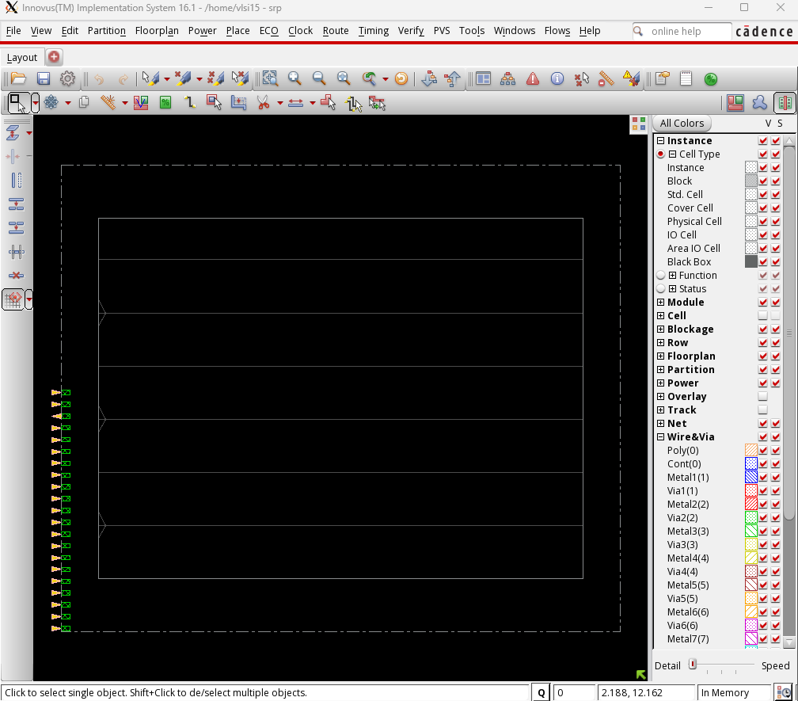
9.3 Physical Design(IO ports)

Slide 35
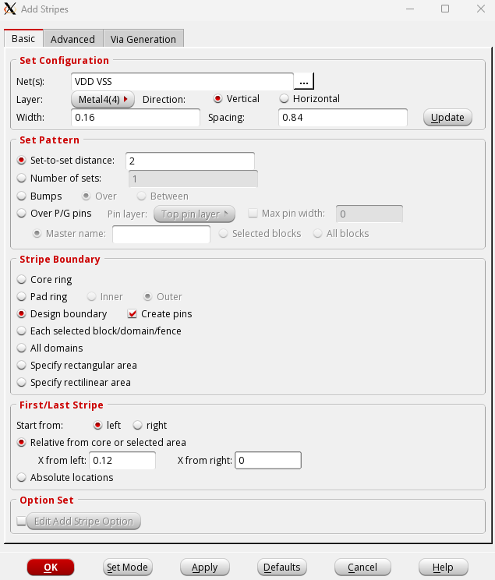
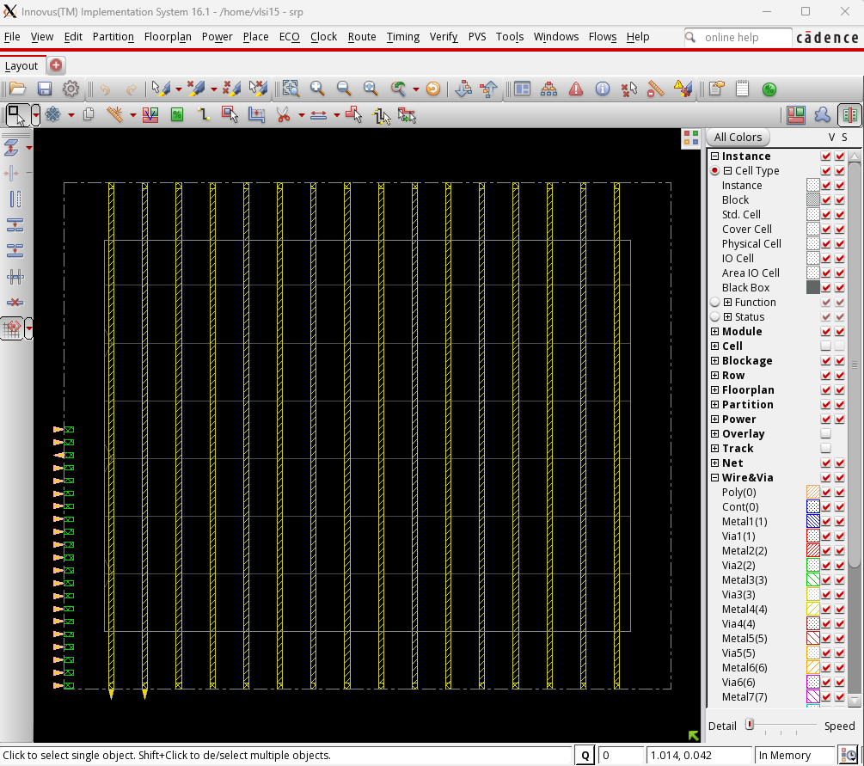
9.4 Physical Design(Adding Stripes)

Slide 36
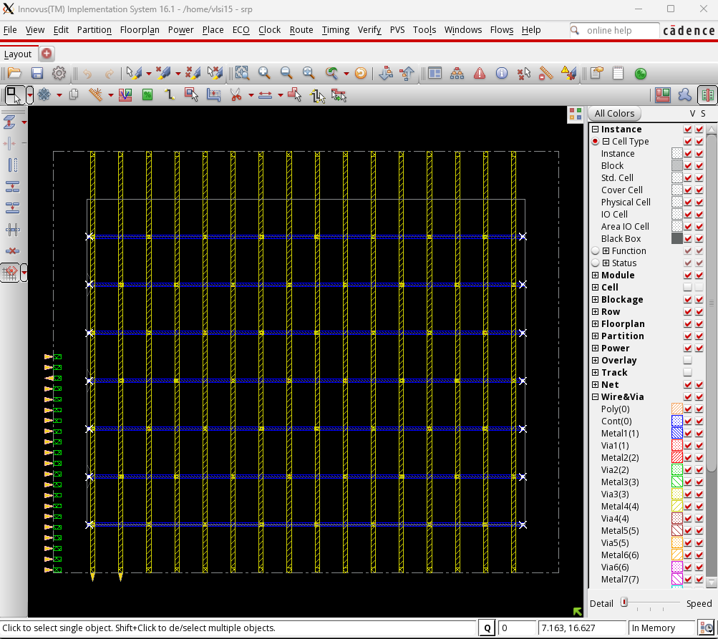

9.5 Physical Design(Routing)

Slide 37

9.6 Physical Design(Placement)

Slide 38


9.7 Physical Design(CTS)
Timing Report

Slide 39


9.8 Physical Design(Nano-routing)

Slide 40

9.9 Physical Design(Post-Route timing and SI Optimization )

Slide 41


9.10 Physical Design(filler cell and metal filling)

Slide 42


Slide 43

9.11 Physical Design(exporting data)
creating srp.merged file and fixing the file destination

Slide 44


9.12 Physical Design(DRC results)
To check the DRC results, we will use Cadence Virtuoso.

Slide 45


We have edited the dislay option to get the first figure. Then we removed labels by unticking them to get second diagram.

Slide 46


Slide 47
10 Conclusion
In this project, we could successfully implement our design.Directed verification was helpful to verify for a few sets of inputs. But layered verification checks for all the inputs. In layered verification, we have divided the testbench into several classes for better understanding. Once the verification was done, we implemented our RTL design and optimize the design. After that, we synthesized our project and generated netlists along with power and area reports. Finally we completed the physical design following various steps.

Slide 48
THANK YOU

